Slide 1
Lexical Analysis
Lecture 02

Slide 2


Role of the Lexical Analyzer
Identify the words: Lexical Analysis
Converts a stream of characters (input program) into a stream of tokens.
Also called Scanning or Tokenizing
Identify the sentences: Parsing.
Derive the structure of sentences: construct parse trees from a stream of tokens.
Next_char()
Next_token()
Input
Scanner
Parser
character
token
Symbol
Table

Slide 3
Interaction of Lexical Analyzer with Parser
Next_char()
Next_token()
Input
Scanner
Parser
character
token
Symbol Table
Often a subroutine of the parser
Secondary tasks of Lexical Analyzer
Strip out comments and white spaces from the source
Correlate error messages with the source program
Preprocessing may be implemented as lexical analysis takes place

Slide 4
Issues in lexical analysis
Simplicity/Modularity: Conventions about “words" are often different from conventions about “sentences".
Efficiency: Word identification problem has a much more efficient solution than sentence identification problem.
Portability: Character set, special characters, device features.

Slide 5
Terminology
Token: Name given to a family of words.
e.g., tok_integer_constant
Lexeme: Actual sequence of characters representing a word.
– e.g., 32894
Pattern: Notation used to identify the set of lexemes represented by a token.
e.g., digit followed by zero or more digits
Token Sample | Lexemes | Pattern
tok_while | while | while
tok_integer_constant | 32894, -1093, 0 | digit followed by zero or more digits
tok_relation | <, <=, =, !=, >, >= | < or <= or = or != or >= or >
tok_identifier | buffer_size, D2 | letter followed by letters or digits

Slide 6
Token Stream
Tokens are terminal symbol in the grammar for the source language
keywords, operators, identifiers, constants, literal strings, punctuation symbols etc. are treated as tokens
Source:
if ( x == -3.1415 ) /* test x */ then ...
Token Stream:
< IF >
< LPAREN >
< ID, “x” >
< EQUALS >
< NUM, -3.14150000 >
< RPAREN >
< THEN >
...

Slide 7
Token Attributes
More than one lexeme matches a pattern
We need attribute to distinguish them
e.g. “tok_relation” matches “< or <= or = or != or >= or >”
< tok_integer_constant, 1415 >
token type token attribute (if available)
Lexical analyzer collects information about tokens and as well as their attributes
Attributes influence the translation of tokens
A token usually has only a single attribute
A pointer to the symbol-table entry
Other attributes (e.g. line number, lexeme) can be stored in symbol table
Example:
– E = M * C ** 2
<tok_identifier, pointer to symbol table entry for E>
<tok_assign, >
<tok_identifier, pointer to symbol table entry for M>
......

Slide 8
Lexical Error
Few errors can be caught by the lexical analyzer
Most errors tend to be “typos”
Not noticed by the programmer
return 1.23;
retunn 1,23;
... Still results in sequence of legal tokens
<ID, “retunn”> <INT,1> <COMMA> <INT,23> <SEMICOLON>
No lexical error, but problems during parsing!
Another example: fi (a == f(x))
Errors caught by lexer:
EOF within a String / missing ”
Invalid ASCII character in file
String / ID exceeds maximum length
etc...

Slide 9
Recovery from lexical errors
Panic mode recovery
Delete successive characters from the input until the lexical analyzer can find a well-formed token
– “…….day = 30 ^^^ month; …….”
May confuse the parser
The parser will detect syntax errors and get straightened out (hopefully!)
Other possible error-recovery actions
Deleting an extra character
Inserting a missing character
Replacing an incorrect character by a correct character
Swapping two adjacent character
– Attempt to repair the input using single error transformations

Slide 10
Implementing a lexical analyzer
assembly language
system-programming language lexical-analyzer generator
Harder to implement
Faster

Slide 11
Input Buffering
For identifying the right lexeme-
We often lookahead one or more character beyond the next lexeme
We cannot be sure if we have seen the end of an identifier until we see a character
In C, we have single character operator such as -, = or <
We also have two character operators ->, == or <=
For this, a two buffer scheme is introduced to handle large lookaheads
Option 1: Read one char from OS at a time with one system call
Option 2: Read N characters with single system read command
– e.g., N = 4096 (Size of a disk block)

Slide 12
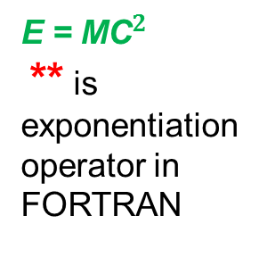
Managing Input Buffers
E = ${\text{MC}}^{2}$
** is exponentiation operator in FORTRAN
If fewer than N characters in the input file then a special character ‘eof’ makes the end
.. |  | E |  | = |  | M |  | * |  | C |  | * | * |  | 2 | ..
lexemeBegin:
makes the beginning of current lexeme
forward: scans ahead until a pattern match is found
Buffer pairs are used to store the input string
For a single buffer scheme, if the lexeme is too long, it will cross the buffer boundary and the buffer need to be refilled
Problem with single buffer scheme is that the lexeme will be overwritten
The overcome this issue, buffer pairs are used where it follows two buffer scheme

Slide 13
Buffer Pairs
Token could overlap / span buffer boundaries
12.46
Solution: Use a paired buffer of N characters each
N-characters N-characters
.. | .. | .. | .. | .. | .. | .. | .. | .. | .. | .. | .. | .. | .. | 1 | 2 | .
4 | 6 | .. | .. | .. | .. | .. | .. | .. | .. | .. | .. | .. | .. | .. | .. | ..
.. | .. |  |  | E |  | = |  | M |  | * |  | C | * | * | 2 | \0
Deficiency:
forward lexeme_beginning
Code:
if (forward at end of buffer1) then
relaod buffer2; forward = forward +1;
else if (forward at end of buffer2) then relaod first half;
move forward to the beginning of the buffer1
else
forward = forward +1

Slide 14
Sentinels
Technique: Use “Sentinels” to reduce testing
Choose some character that occurs rarely in most inputs e.g. ‘\0’ or ‘eof’
N-characters
N-characters
.. | .. |  |  | E |  | = |  | M | * | \0 |  | C | * | * | 2 | \0 |  |  |  |  | \0
forward lexeme_beginning
forward++;
if *forward == ‘\0’ then
if forward at end of buffer #1 then
Read next N bytes into buffer #2;
forward = address of first char of buffer #2; else if forward at end of buffer #2 then
Read next N bytes into buffer #1;
forward = address of first char of buffer #1;
else
// do nothing; a real \0 occurs in the input
endif endif

Slide 15
Specification of Tokens
Regular languages are the most popular formalism for specifying tokens
Languages: Let ∑ be a set of characters
A language over ∑ is a set of strings of characters drawn from ∑
Example:
Alphabet | Language
English characters | English sentences
ASCII | C programs
N.B: Not every string of English characters is an English sentence
Languages are sets of strings and we need some notation for specifying which sets we want. The standard notation for regular languages is Regular Expression.
Regular expression is used to define the rule for identifying valid tokens.
Each regular expression is a pattern specifying the form of strings
Eg: Token < IF > corresponding RE is ‘’IF’’
Comparison operator’s RE is =| > | < | >= | <=

Slide 16
Terminology
Alphabet (∑) : AKA character class
A set of symbols (“characters”)
Examples: ∑ = { 1, 0} : binary alphabet
∑ = { 1, 2, 3, 4, 5, 6 } : Alphabet on dice outcome
String : AKA Sentence or word
Sequence of symbols
Finite in length
– Example: abbadc
Length of s = |s|
Empty String (ε) or NULL string
– L(a) = {ε}, containing only the empty string
– | ε | = 0
Language
A set of strings over some fixed alphabet
Examples: L1 = { a, baa, bccb } L2 = { }
Each string is finite in length, but the set may have an infinite number of elements.
L3 = {ε}
Note the difference
L4 = {ε, ab, abab, ababab, abababab,... }

Slide 17
Terminology
Prefix ...of string s
String obtained by removing zero or more trailing symbols
s = hello
Prefixes: ε, h, he, hel, hell, hello
Suffix ...of string s
String obtained by deleting zero or more of the leading symbols
s = hello
Suffixes: hello, ello, llo, lo, o, ε
Substring ...of string s
String obtained by deleting a prefix and a suffix
s = hello
Substrings: ε. ell, hel, llo, hello, ….
Proper prefix / suffix / substring ... of s
String s1 that is respectively prefix, suffix, or substring of s such that s1 ≠ s and s1 ≠ ε
Subsequence….of string s
String formed by deleting zero or more not necessarily contiguous symbols
S=hello
Subsequence: hll, eo, hlo, etc.

Slide 18
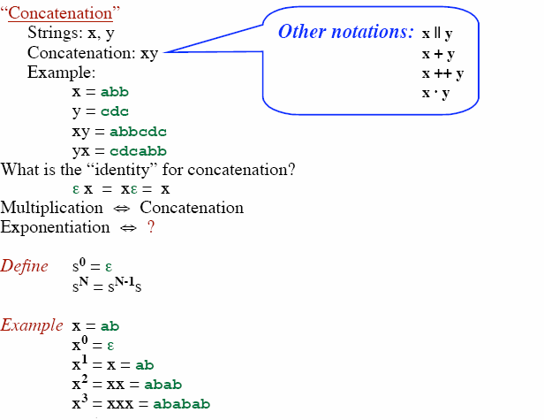
Terminology

Slide 19
Terminology
Language
A set of strings
– L = { ... }
– M = { ... }
Union of two languages
L ∪ M = { s | s is in L or is in M }
Example:
L = { a, ab }
M = { c, dd }
L ∪ M = { a, ab, c, dd }
Concatenation of two languages
L M = { st | s is in L and t is in M }
Example:
L = { a, ab }
M = { c, dd }
L M = { ac, add, abc, abdd }

Slide 20
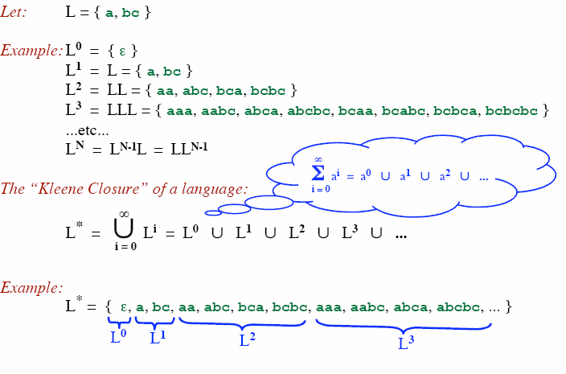
Kleene closure

Slide 21
Positive closure
Let: L = { a, bc }
Example: L⁰ = { ε }
L¹ = L = { a, bc }
L² = LL = { aa, abc, bca, bcbc }
L³ = LLL = { aaa, aabc, abca, abcbc, bcaa, bcabc, bcbca, bcbcbc }
...etc...
_{L}N _{= L}N-1_{L = LL}N-1
The “Positive Closure” of a language:
∞
+
∪
i 1 2 3
L =
L = L ∪ L ∪ L ∪…
i=1
Note ε is not included UNLESS it is in L to start with
Example:
L⁺ = { a, bc, aa, abc, bca, bcbc, aaa, aabc, abca, abcbc, ... }
_{L}1 _{L}2 _{L}3

Slide 22
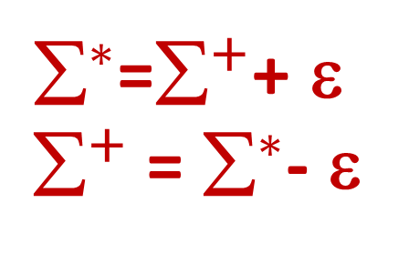
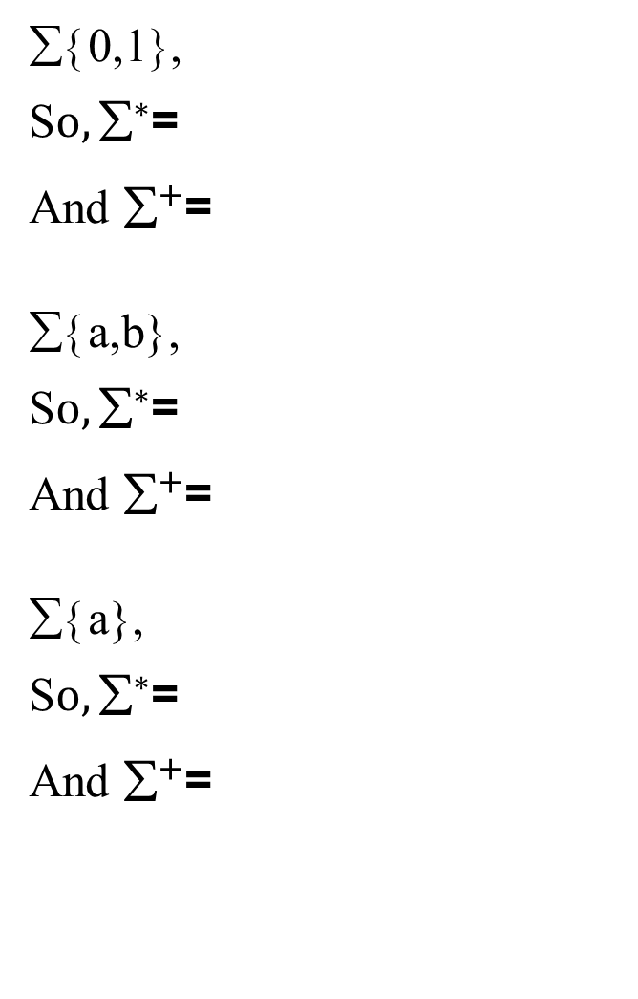
Kleen Closure & Positive Closure Examples
${\text{}}^{∗}$=${\text{}}^{+}$+ ε
${\text{}}^{+}$ = ${\text{}}^{∗}$- ε
∑{0,1},
S$o,{\text{∑}}^{∗}$=
And ${\text{}}^{+}$=
∑{a,b},
S$o,{\text{∑}}^{∗}$=
And ${\text{}}^{+}$=
∑{a},
S$o,{\text{∑}}^{∗}$=
And ${\text{}}^{+}$=

Slide 23
Example
Let:
L = { a, b, c, ..., z }
D = { 0, 1, 2, ..., 9 }
D⁺ = “The set of strings with one or more digits”
L ∪ D = “The set of alphanumeric characters”
{ a, b, c, ..., z, 0, 1, 2, ..., 9 }
( L ∪ D )* = “Sequences of zero or more letters and digits”
L ( ( L ∪ D )* ) = “Set of strings that start with a letter, followed by zero or more letters and digits.”

Slide 24
Definition: Regular Expressions
(Over alphabet ∑)
ε is a regular expression.
If a is a symbol (i.e., if a∈ ∑, then a is a regular expression.
If R and S are regular expressions, then R|S is a regular expression.
If R and S are regular expressions, then RS is a regular expression.
If R is a regular expression, then R* is a regular expression.
If R is a regular expression, then (R) is a regular expression.

Slide 25
Regular Expressions and Language
(Over alphabet ∑)
And, given a regular expression R, what is L(R) ?
ε is a regular expression.
– L(ε) = { ε }
Language containing only null string
If a is a symbol (i.e., if a∈ ∑, then a is a regular expression. Here, suppose ∑ = {a,b,c}
– L(a) = { a }
Containing only a single valid string
If R and S are two regular expressions with languages L(R) and L(S), then R|S is a regular expression denoting the language
Where, L(R) is set of strings in the language with R as regular expression and L(S) is set of strings in the language with R as regular expression
– L(R|S) = L(R) ∪ L(S), containing all the strings of L(R) and L(S)

Slide 26
Regular Expressions and Language
If R and S are regular expressions, then RS is a regular expression.
– L(RS) = L(R) L(S), created by concatenation of L(S) to L(R)
Suppose, L(R) = {ab}
L(S) = {bc}
So, L(RS) = {ab, bc}
Similarly,
L(R) = {a, ab, ac}
L(S) = {x, y}
So, L(RS) = {ax, ay, abx, aby, acx, acy}
If R is a regular expression, then R* is a regular expression.
The * means zero or more occurrence of the regular expression R
– L(R*) = (L(R))*
Suppose, L(R) = {a, ab}
Then (L(R))* = {ε, a, ab, aa, aab, abab, aba, …}
This set is infinite
If R is a regular expression, then (R) is a regular expression.

Slide 27
Regular Definition
If Σ is an alphabet of basic symbols then a regular definition is a sequence of the following form:
d₁→r₁ d₂→r₂
…….. d_{n}→r_{n}
where
Each d_{i} is a new symbol such that d_{i} ∉ Σ and d_{i} ≠ d_{j}
where j < I
Each r_{i} is a regular expression over Σ ∪ {d₁,d₂,…,d_{i-1})

Slide 28
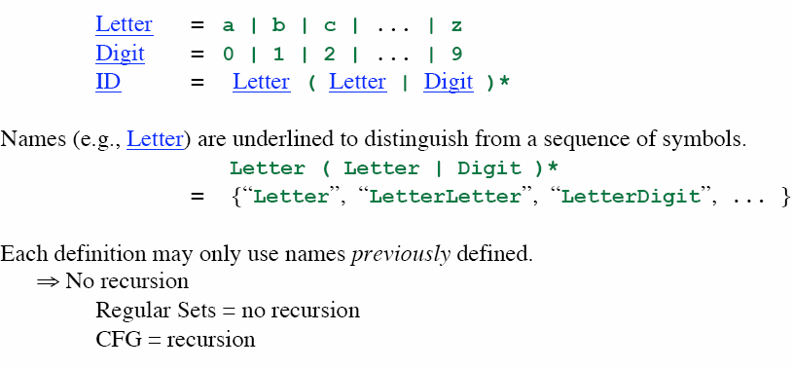
Regular Definition
E.g. for ID: ab, a1, ab2, abcd2
2a, 23b will be invalid

Slide 29
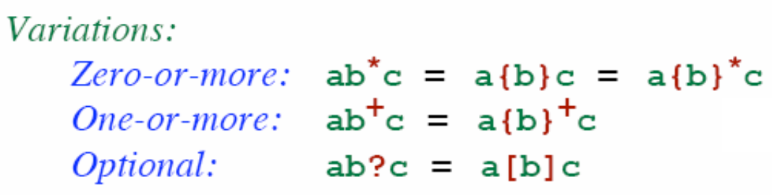
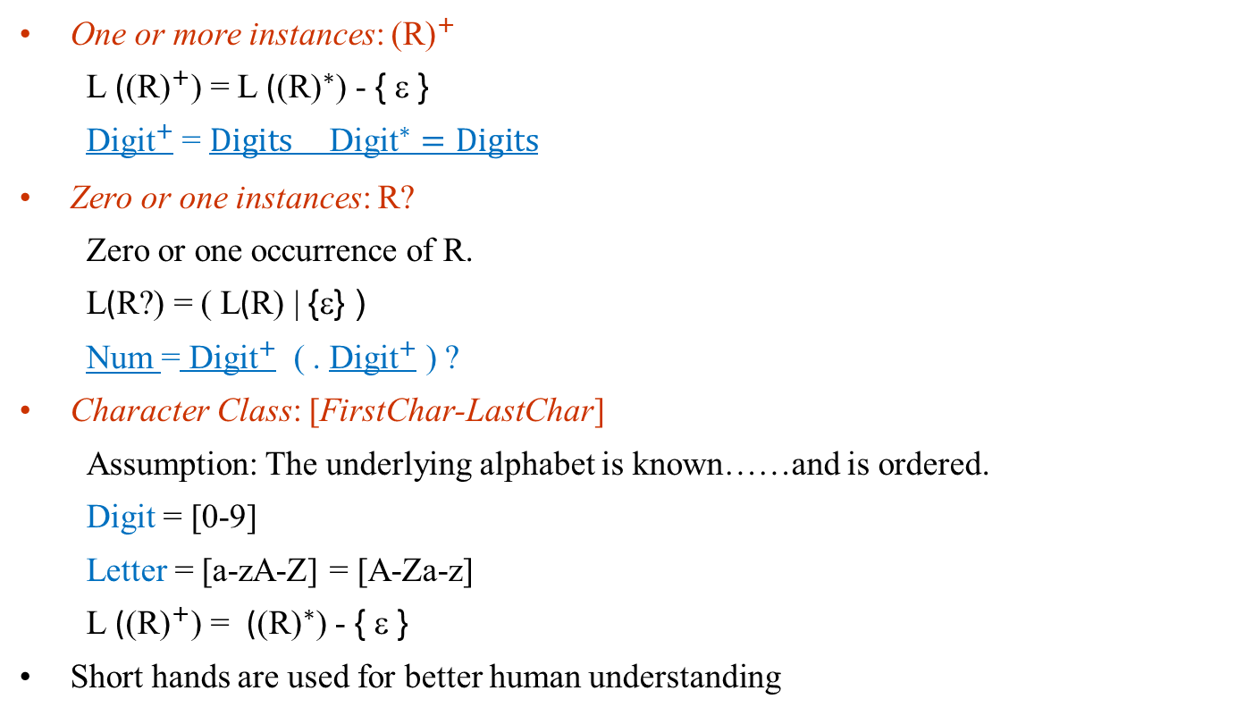
Extensions / Shorthand
One or more instances: ${\text{(}\text{R}\text{)}}^{+}$
L (${\text{(}\text{R}\text{)}}^{+}$) = L (${\text{(}\text{R}\text{)}}^{∗}$) - { ε }
${\text{Digit}}^{+}$ = $Digits {\text{Digit}}^{∗}=Digits$
Zero or one instances: ${\text{R}\text{?}}^{}$
Zero or one occurrence of R.
L(R?) = ( L(R) | {ε} )
Num = ${\text{Digit}}^{+}$ ( . ${\text{Digit}}^{+}$ ) ?
Character Class: [FirstChar-LastChar]
Assumption: The underlying alphabet is known……and is ordered.
Digit = [0-9]
Letter = [a-zA-Z] = [A-Za-z]
L (${\text{(}\text{R}\text{)}}^{+}$) = (${\text{(}\text{R}\text{)}}^{∗}$) - { ε }
Short hands are used for better human understanding

Slide 30
Exapmples with ∑ = {0, 1}
(0|1)*: All binary strings including the empty string
(0|1) (0|1)*: All nonempty binary strings
0(0|1)*0: All binary strings of length at least 2, starting and ending with 0s
(0|1)*0 (0|1) (0|1) (0|1): All binary strings with at least four characters in which the fourth -last character is always 0
Eg: 0010010101
0*10*10*10*: All binary strings possessing exactly three 1s

Slide 31
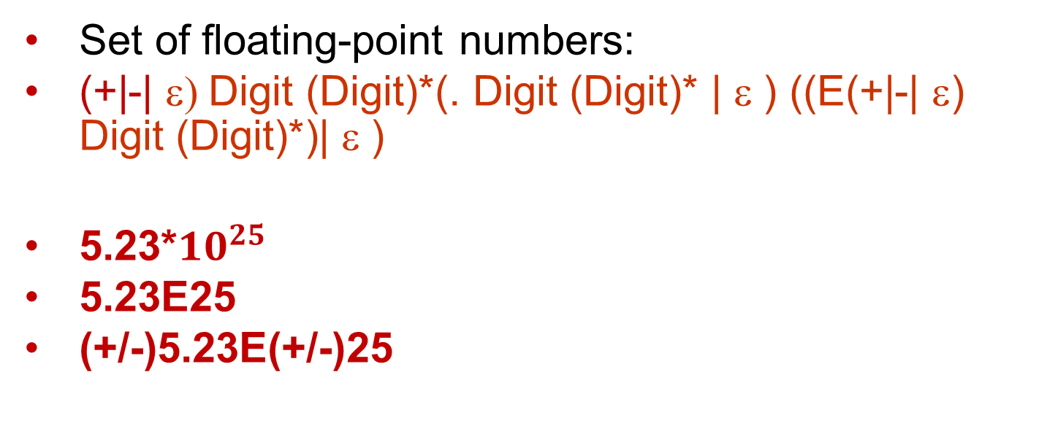
Exapmples
Set of floating-point numbers:
(+|-| ε) Digit (Digit)*(. Digit (Digit)* | ε ) ((E(+|-| ε) Digit (Digit)*)| ε )
5.23*${10}^{25}$
5.23E25
(+/-)5.23E(+/-)25

Slide 32
How to “Parse” Regular Expressions
Precedence:
* has highest precedence.
Concatenation as middle precedence.
| has lowest precedence.
Use parentheses to override these rules.
Examples:
– a b* = a (b*)
If you want (a b)* you must use parentheses.
a | b c = a | (b c)
If you want (a | b) c you must use parentheses.
Concatenation and | are associative.
– (a b) c = a (b c) = a b c
– (a | b) | c = a | (b | c) = a | b | c
Example:
– b d | e f * | g a = (b d) | (e (f *)) | (g a)

Slide 33
Regular Language
Definition: “Regular Language” (or “Regular Set”)
... A language that can be described by a regular expression.
Any finite language (i.e., finite set of strings) is a regular language.
Regular languages are (usually) infinite.
Regular languages are, in some sense, simple languages.
Regular Languages ⊂ Context-Free Languages
Examples:
a | b | cab
b*
a | b*
– (a | b)*
{a, b, cab}
{ε, b, bb, bbb, ...}
{a, ε, b, bb, bbb, ...}
{ε, a, b, aa, ab, ba, bb, aaa, ...}
“Set of all strings of a’s and b’s, including ε.”

Slide 34
Equality vs Equivalence
Are these regular expressions equal?
R = a a* (b | c)
S = a* a (c | b)
... No!
Yet, they describe the same language. L(R) = L(S)
“Equivalence” of regular expressions If L(R) = L(S) then we say R ≅ S “R is equivalent to S”
From now on, we’ll just say R = S to mean R ≅ S

Slide 35
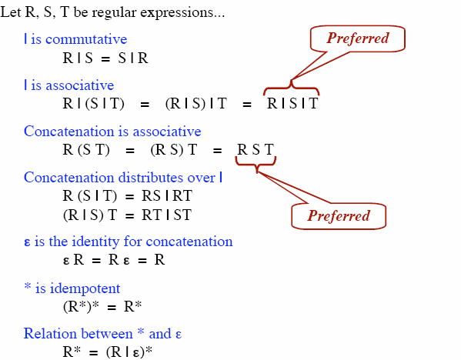
Algebraic law of regular expressions

Slide 36
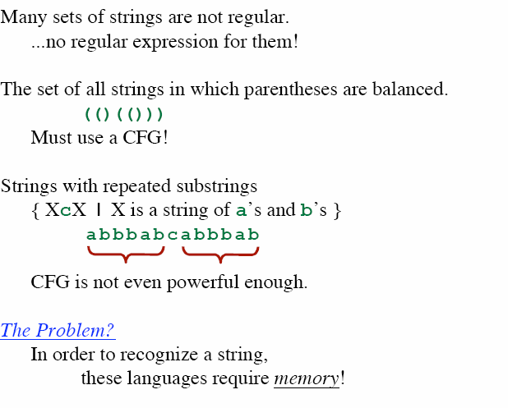
Nonregular sets

Slide 37
Problem: How to describe tokens?
Solution: Regular Expressions
Problem: How to recognize tokens?
Approaches:
Hand-coded routines
Finite State Automata
Scanner Generators (Java: JLex, C: Lex)
Scanner Generators
Input: Sequence of regular definitions
Output: A lexer (e.g., a program in Java or “C”)
Approach:
Read in regular expressions
Convert into a Finite State Automaton (FSA)
Optimize the FSA
Represent the FSA with tables / arrays
Generate a table-driven lexer (Combine “canned” code with tables.)

Slide 38
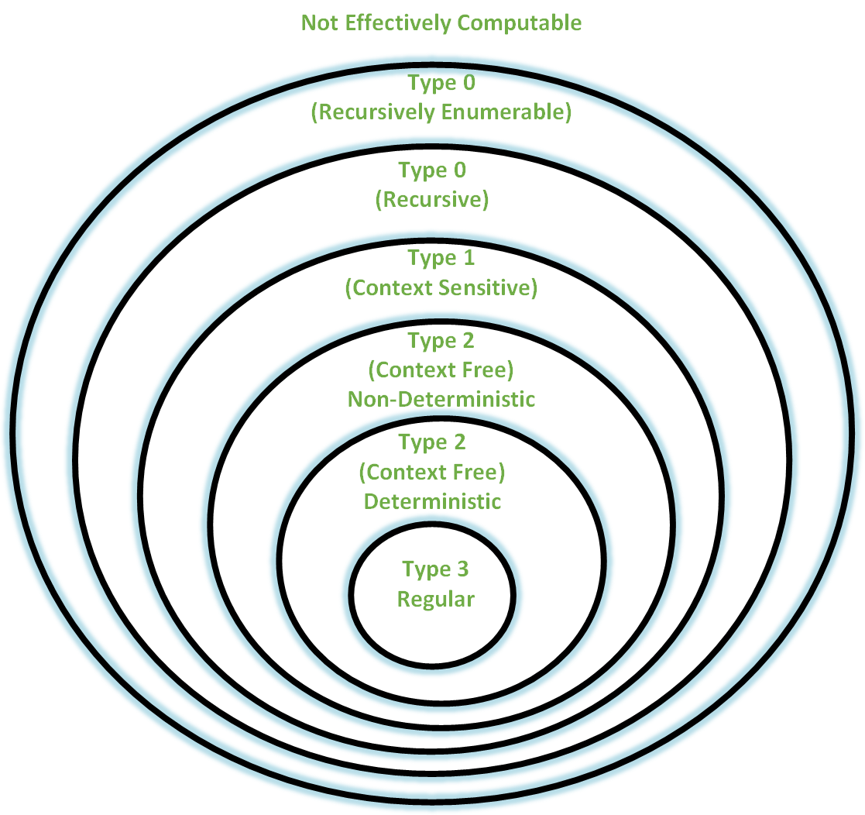
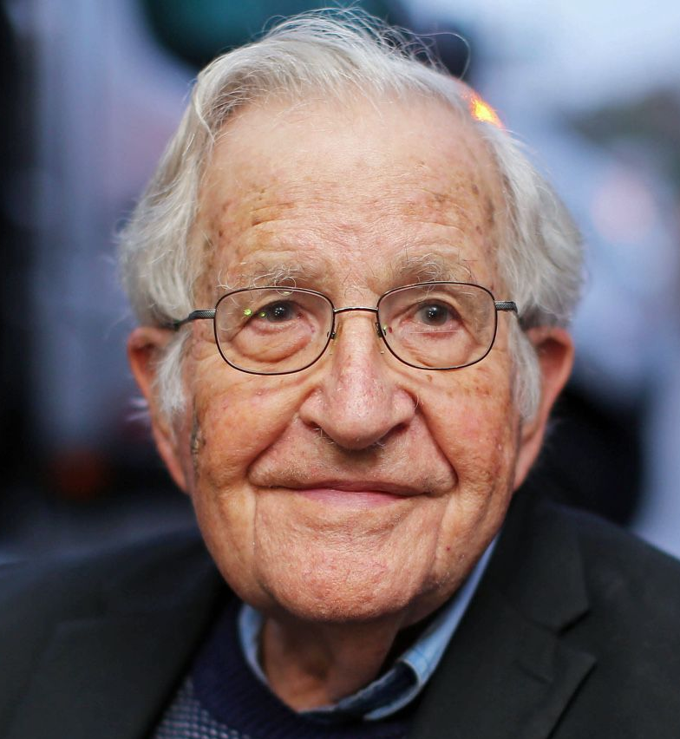
Chomsky Hierarchy

Slide 39
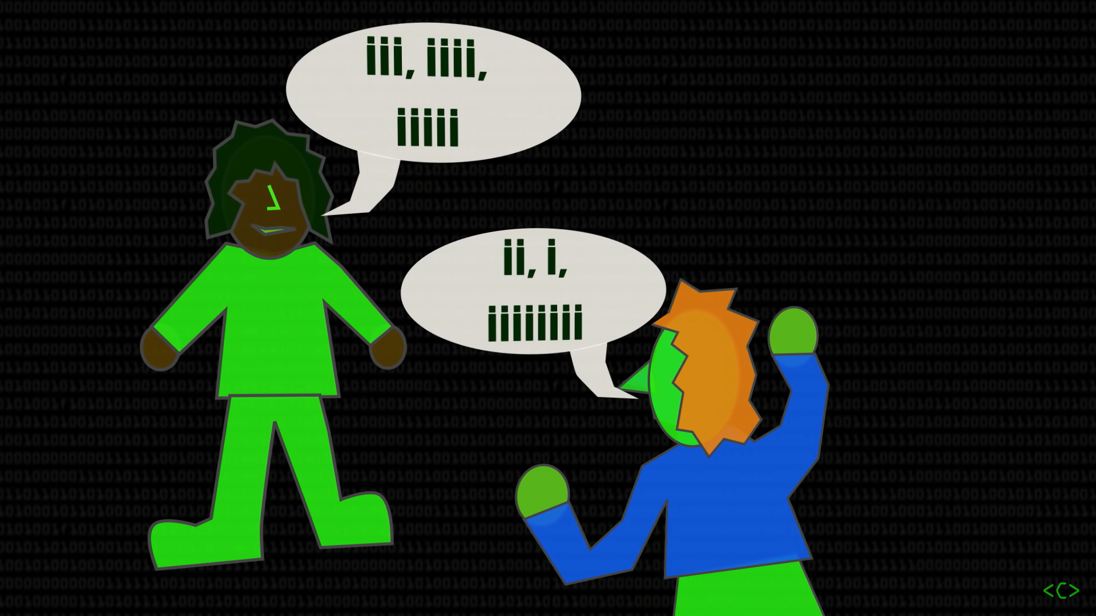
Just imagine, a language consisting of just ‘i’.
Image source: Computerphile

Slide 40

Well, almost same as “I am Groot” used by Groot from The Guardians of the Galaxy

